Slide 1
Sales Forecasting
Submitted in the partial fulfillment for the award of the degree of
BACHELOR OF ENGINEERING
IN
SPECIALIZATION WITH Artificial Intelligence & Machine Learning
Submitted by:
Aryan Gupta(20BCS6656)
Sheikh Shahnawaz(20BCS6628)
Ankith Raj(20BCS6684)
Aryan Kushwaha(20BCS6691)
Under the Supervision of:
Dr. Alankrita Aggarwal
Department of AIT-CSE
DISCOVER . LEARN . EMPOWER

Slide 2
Outline
Introduction to Project
Problem Formulation
Objectives of the work
Methodology used
Results and Outputs
Conclusion
Future Scope
References

Slide 3
What is Sales Forecasting?
Sales forecasting is one of the most important things a company does. It fuels sales planning and is used throughout an enterprise for staffing and budgeting. Despite its importance, many organizations use outmoded practices that produce bad forecasts.
A comparison could be drawn with times past, when farmers depended on signals like cats washing behind their ears or the ache in an old-timer’s knee to forecast the weather. With the advent of supercomputers, weather prediction has vastly improved. But in large enterprises, the tools used to foresee sales remain only somewhat more reliable than an arthritic knee.

Slide 4
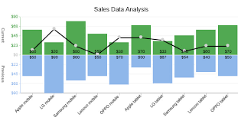
Sales Data
Sales data is any information that can be used by a sales team to make informed decisions. It offers valuable insights into a team's performance, allowing them to develop better sales strategies and improve organisational decision-making.
How is sales data used?
Sales data can be used by your team to:
1. Identify new opportunities
2. Avoid pursuing bad-fit customers
3. Enable effective prospecting
4. Optimize the sales process
5. Provide sales forecasts
6. Track performance against key objectives

Slide 5
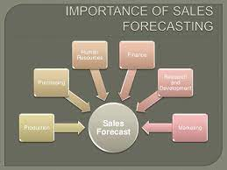
Why opt Sales Forecasting?
Sales forecasting allows companies to:
Efficiently allocate resources for future growth and manage its cash flow.
Sales forecasting also helps businesses to estimate their costs and revenue accurately based on which they are able to predict their short-term and long-term performance.

Slide 6
Objectives
The proposed work is aimed to carry out work leading to the development of an approach for predicting sales. The sales forecasting system, which is proposed work will be achieved by dividing the work into the following objectives:
Obtain the Big Mart dataset from Kaggle.
Perform data wrangling.
Work on different Machine learning algorithm.
Try to develop algorithm based on different models to achieve maximum accuracy.
To develop the GUI using flask and deploy the model with AWS.

Slide 7
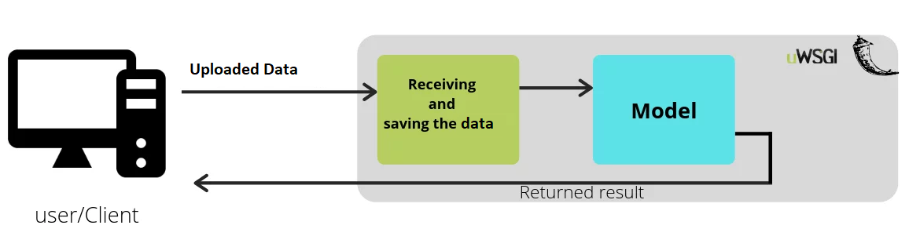
Methodology used
The system flowchart of our project, which is based on Sales Forecasting, is illustrated in the diagram. It is split into two parts: the backend and the frontend. The Bigmart dataset make up the backend element. The Python code is separated into preprocessing, model building, training, and prediction sections.
Flask is a micro web framework written in Python, is what we used for the front-end and connecting to Python Code. Front End is made Using HTML/CSS and consists of various input fields like Item weight, Item visibility, Item Type, Item MRP, Outlet Type, Outlet Location type. User will enter values in these fields and the values will be passed to model and the result of future outlet sales will be shown to the user in JSON Format

Slide 8
Results and Outputs
The sales of several Big Mart outlets have been predicted using machine learning methods like Linear Regression, KNearest Neighbors, XGBoost, and Random Forest. For each of the four methods, many metrics that affect the accuracy of results are tabulated, including Root Mean Squared Error (RMSE), Variance Score, Training and Testing Accuracy, and more.

Slide 9
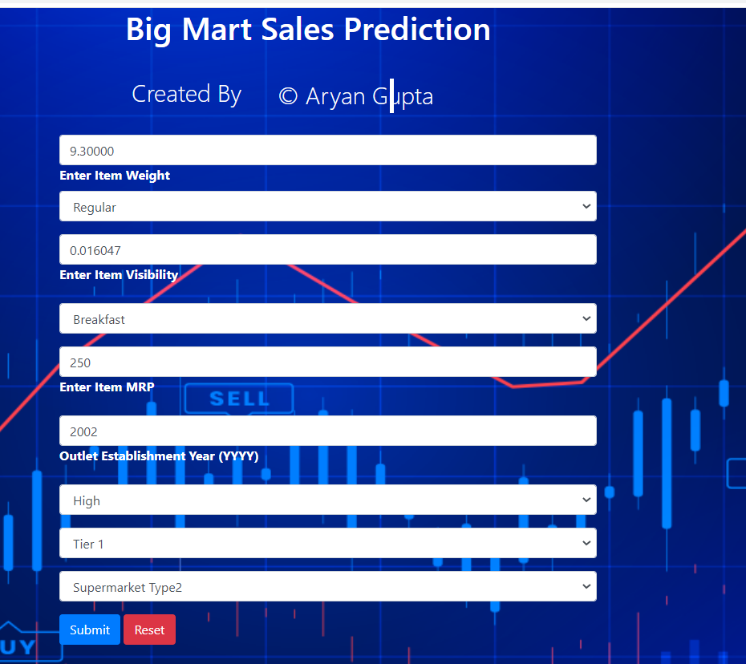
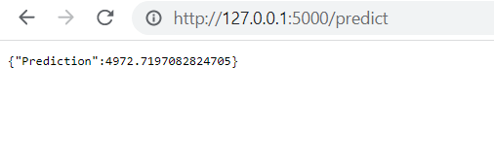

Slide 10
Conclusion
Therefore, the sales forecasts definition explains it as an indicator of what will likely happen in a specified time frame within a particular field. Also, The basic objective is correct decision making along with the importance to guide the business. However, to help the company there are various sales forecasting methods used according to the nature of business by the firms. There is a certain degree of predictability when it comes to sales patterns, according to the analysis and modelling done for the sales forecasting project. It is feasible to estimate future sales success by examining previous data and applying the right forecasting tools

Slide 11
Future Scope
Real-time prediction: The ability to predict sales in real-time can be a game-changer for businesses, allowing them to quickly adjust their strategies based on market trends and customer behavior. User can Upload there CSV Files of any organization and get the future sales
2) We intend to expand this research to a larger scale in the future so that different embedding models can be considered on a wider range of datasets
3) To create an android application based on this machine learning model.
4) To integrate this model to an offline based system so that it runs completely without an internet connection
5) To Deploy the Project on Platform like AWS so that anyone with the Link can have access to it.

Slide 12
References
https://www.kaggle.com/datasets/shivan118/big-mart-sales-prediction-datasets
https://hbr.org/1971/07/how-to-choose-the-right-forecasting-technique
https://www.liveplan.com/blog/the-best-way-to-forecast-sales-and-revenue/
https://portal.abuad.edu.ng/lecturer/documents/1588001295ICH_254_NOTE_2.pdf
Gudmundsson, K., & Helgason, H. (2020). Machine learning in sales forecasting. Available at: https://www.arnia.com/blog/machine-learning-in-sales-forecasting
Hu, Y., Yang, H., & Chao, C. (2018). Sales Forecasting with a Hybrid Method of ARIMA and XGBoost. In 2018 IEEE International Conference on Systems, Man, and Cybernetics (SMC) (pp. 2813-2818). IEEE.
Sarkar, S., Rana, S., & Kumar, S. (2021). Sales forecasting using machine learning algorithms: A comprehensive review. Journal of Retailing and Consumer Services, 59, 102376.
https://www.yesware.com/blog/sales-forecast/

